Slide 1
We are on a
WARFOOT
against
MOHARRAMAAT

Slide 2
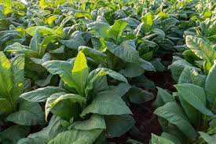
What is Tobacco ?
A woody shrub plant with big leaves.
4000+ chemicals in tobacco ( all cause health issues )
Nicotine is one of them

Slide 3
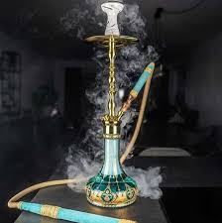
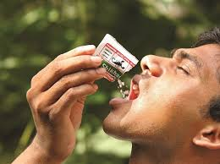
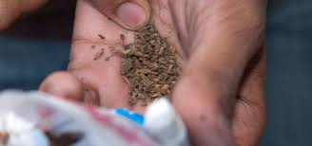
TYPES OF TOBACCO PRODUCTS There is no safe form of tobacco use. All forms contain nicotine and can cause addiction and health problems
HOOKAH BIDI DISSOLVABLE TOBACCO GUTKHA

Slide 4
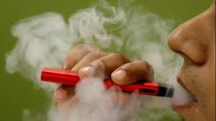
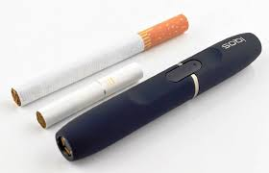
SMOKE-LESS CIGARETTES

Slide 5
NICOTINE
NICOTINE is the most harmful substance in tobacco

Slide 6
What are E-cigarettes / Vape
Notes:
Dr Mufaddal bhai Gomberawala
Teacher Talking Points:
E-cigarettes are made of a battery, an atomizer with a heating coil, and an absorbent material that absorbs a liquid that can contain nicotine, flavoring and chemicals.
The battery allows the atomizer to heat the liquid, called e-juice, which creates an aerosol that is breathed into the lungs and breathed out into the air repeatedly.
Some of these devices are pre-loaded with the e-juice that comes in bottles like these and others where the users add it themselves.
The original e-cigarettes looked like a cigarette, came pre-loaded and were disposable.

Slide 7
Working of an E-cigarette.
Notes:
Dr Mufaddal bhai Gomberawala
Teacher Talking Points:
E-cigarettes are made of a battery, an atomizer with a heating coil, and an absorbent material that absorbs a liquid that can contain nicotine, flavoring and chemicals.
The battery allows the atomizer to heat the liquid, called e-juice, which creates an aerosol that is breathed into the lungs and breathed out into the air repeatedly.
Some of these devices are pre-loaded with the e-juice that comes in bottles like these and others where the users add it themselves.
The original e-cigarettes looked like a cigarette, came pre-loaded and were disposable.
None of the liquids are FDA approved or regulated in anyway – so there long term effects are unknown

Slide 9
4th generation e-cigarette
Pod Mods uses nicotine salts- high level of nicotine can be inhaled without irritating the throat

Slide 10
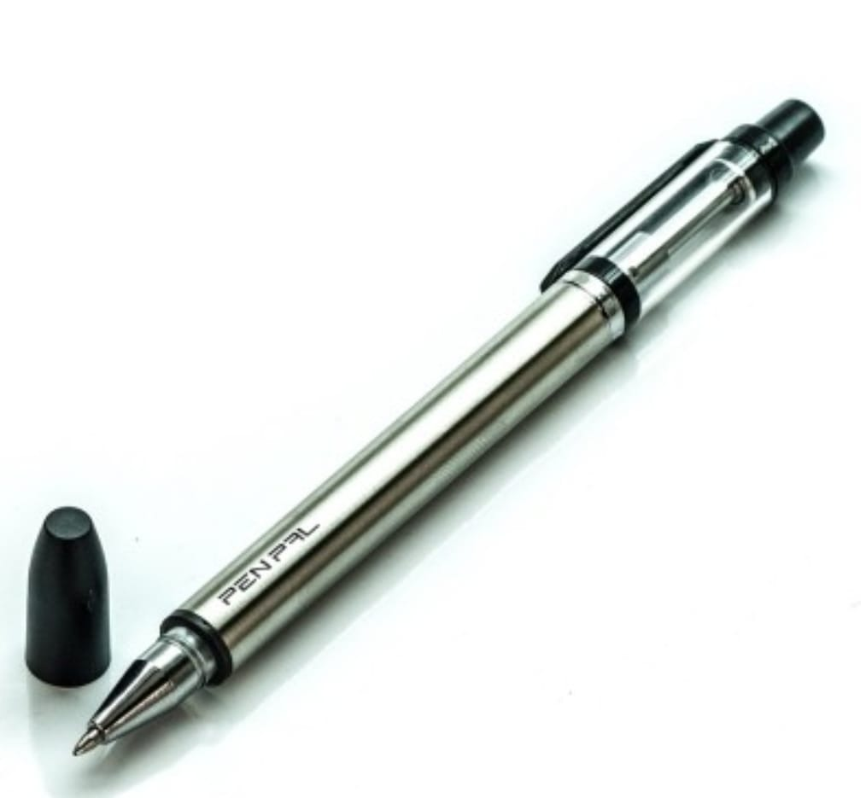

Slide 11
E-Liquid (Nicotine with choice of flavoring substance)

Slide 12
Vaping / e-Cigarette
Why is it so popular ?

Slide 14
During World Cup Football in 45 days 125.000 popup adv

Slide 15
Promotions on social media :
Instagram, Facebook

Slide 16
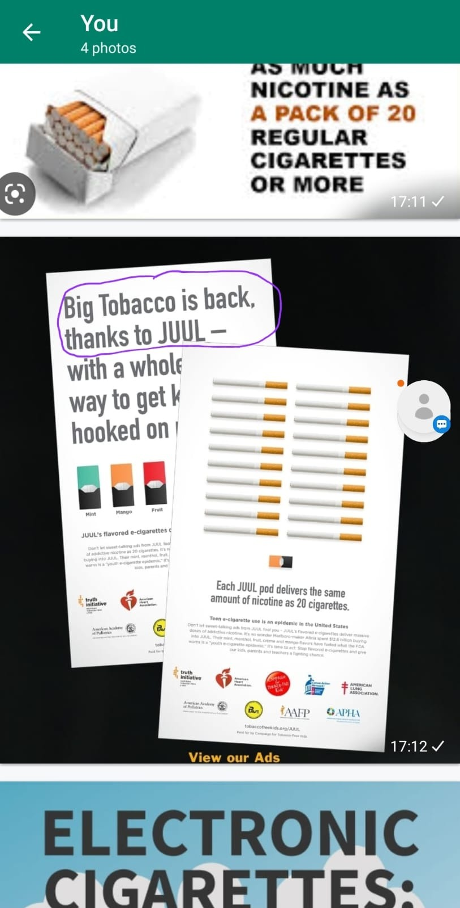

Slide 17
TOBACCO PRODUCTS BEING MARKETED
2020 – 68% e-cigarettes
2023 – 90 % e-cigarettes
(expected)

Slide 18
Nicotine in 1 e-cigarette is equal to 20 regular cigarettes
1 E-cigarette = 20 cigarettes

Slide 19
Nicotine can harm the developing adolescent brain. It affects the parts that help improving memory, mood and impulse control.
Use of these devices may also increase risk for future addiction to other drugs.

Slide 20
With nicotine one may feel good by stimulating production of the “feel good” chemical in the brain called dopamine which can create feelings of pleasure and relaxation.

Slide 21
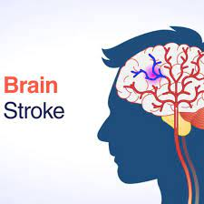
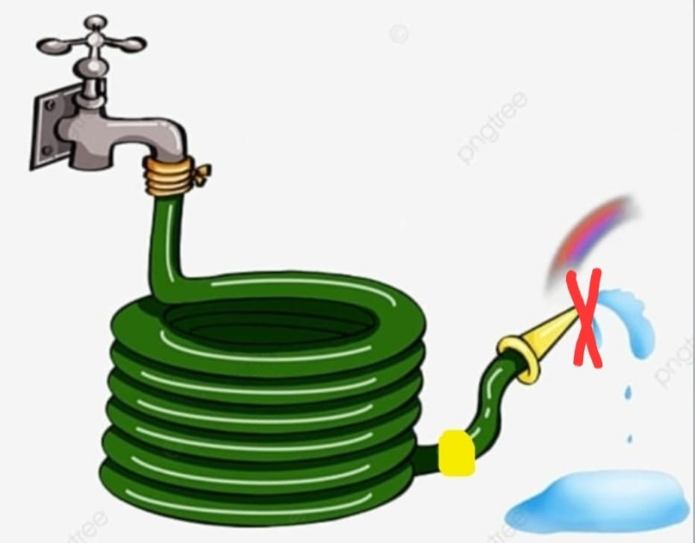
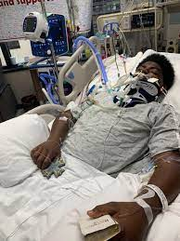
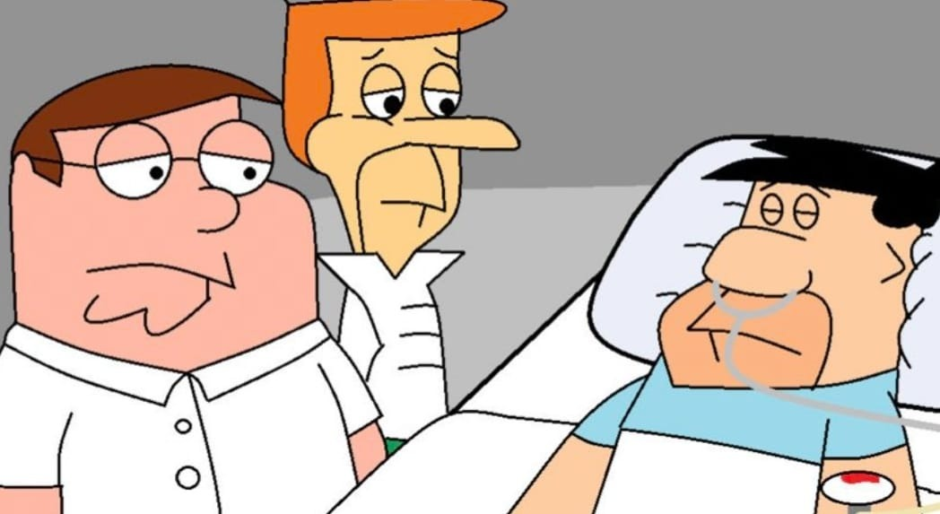

Slide 22
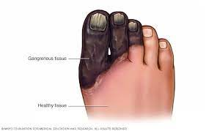
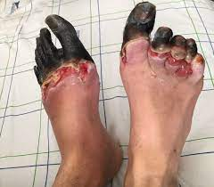
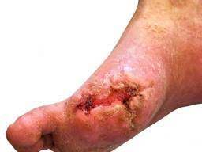
Nicotine can affect all parts of body

Slide 23
What is EVALI ?
EVALI is a serious medical condition in which a person’s lungs get damaged from substances contained in e-cigarettes and vaping products

Slide 24
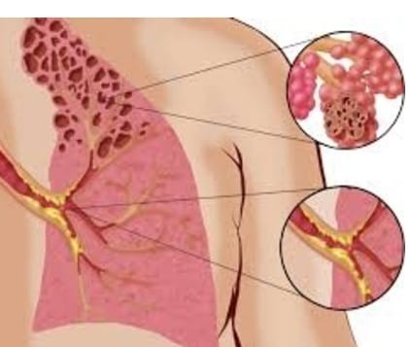
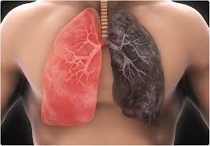
Popcorn Lungs
“Popcorn Lung” (Bronchiolitis obliterans): A
serious irreversible disease that results in
thickening and narrowing of smallest
airways of the lungs.
Symptoms include a dry cough, shortness of
breath, wheezing, and feeling tired
Caused by flavouring agent called diacetyl

Slide 25
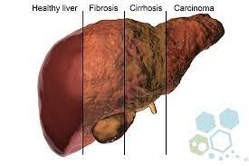
Stomach cancer
Liver cancer

Slide 26
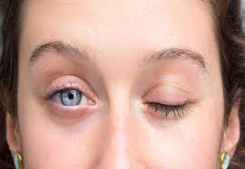
Eye problems including blindness

Slide 27
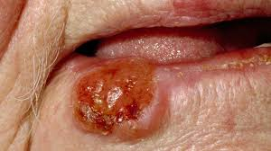
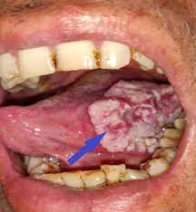
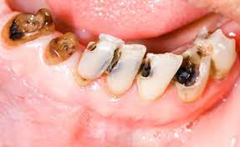
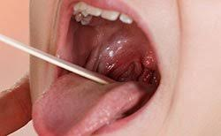
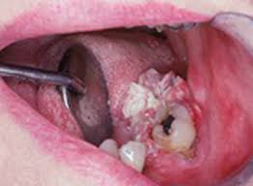
Cancer of Mouth, Oral cavity, Tongue, Larynx

Slide 28
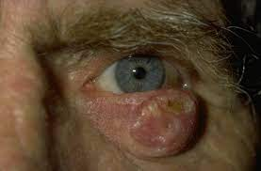
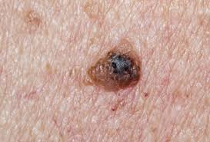
SKIN CANCER

Slide 29
Harmful impacts on the body.
Notes:
Dr Aamir bhai Jamali
Talk about nicotine causes (vasoconstriction) reduced arterial supply and you know the rest ☺
Your own personal experiences with patients…

Slide 30
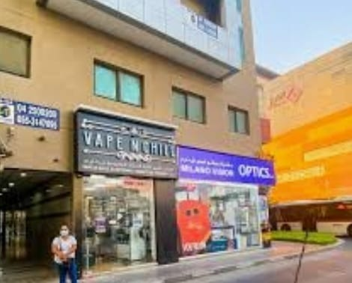
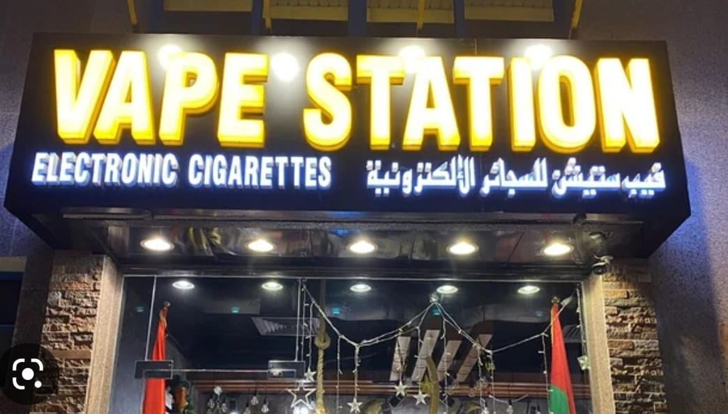
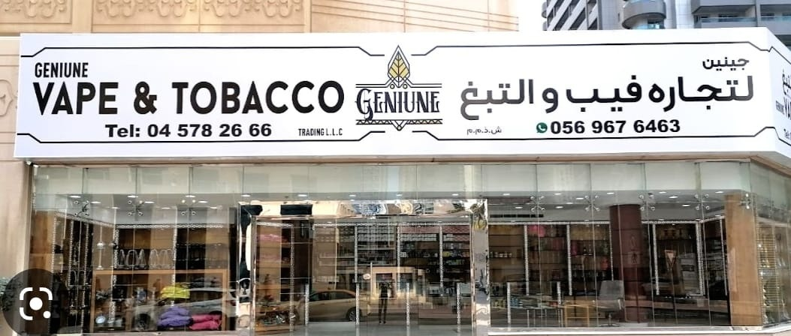

Slide 31
Know the signs of Vaping
Fruity, menthol smells around the children or on their clothes
Any flash drives or personal items that you dont recognize
Any unfamiliar charges or batteries
Any change of kids behaviuor – irritable, mood swings, irritability, anxiety, learning difficulties ?
Sufferings from frequent headaches or nausea , nose bleed
Use of perfumes, desire for flavours

Slide 32
Helpful message for teens
Don’t let others spoil you and spoil your health
Don’t be fooled by celebrities and social media
Don’t waste your money
Don’t mess your body and its parts
Make smart decision and healthy choice

Slide 33
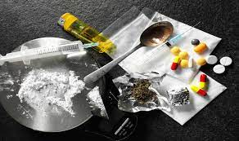

Slide 34
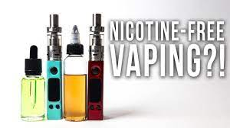

Slide 35
What we can do as parents
YOU can and must intervene
Key is open, early communication
Role Model
Monitor social media
Encourage sports
Stay educated on the trends
Ask for help from professionals
Notes:
Safia ben – LAST SLIDE
As a parent and caregiver, YOU have the utmost important role in protecting your child from e-cigarettes
Have open conversations with your kids and explain the harmful effects these devices can have on them. These conversations can be challenging – and Dr. Lulua ben will share how to overcome these (she presents after you)
The earlier the conversation begins- the more likely they are to listen and have a stronger foundation that won’t fall to peer pressure
Parents should keep themselves educated and up-to-date on these new “trends” so when something is brought up in conversation- they can be aware and step in when necessary
Introduce Dr. Lulua ben Mandviwala – Bakersfield- A pediatrician.

Slide 36
Parenting tips
Ask children if they know about nicotine
Ask children if they know about e-cigarettes
Tell them to find on internet, take printout and let them tell you
Choose right time and place
Compliment good decisions
Ask open ended questions
One conversation is not enough

Slide 37
Thank you
SAY STRAIGHT NO TO E-CIGARETTES
&
VAPING !
UNDERSTAND THE DANGERS & RISK
TO HEALTH & IMMAN !

Slide 38
Khuda ta’ala hamara bawa shafeeq, Syedna Aali Qadr Mufaddal Saifuddin Moula TUS ni umar shareef ne ta Qayamat daraaz karjo. Ameen.
Aap na thanda saya ma mumineen ne abaad shaad rakhjo.
Har kisaam na Moharramaat si bachavjo.
Ameen.

